Slide 1
Adaptive Streaming using DASH with H.264
By Hammad Shafiq and Hassan Farooq

Slide 2
Introduction
What is Adaptive Streaming?
Adaptive streaming dynamically adjusts video quality based on network conditions
Objective:
To implement adaptive streaming using DASH (Dynamic Adaptive Streaming over HTTP) with H.264.

Slide 3
Overview
Convert a video (fish sample) to H.264 format and multiple resolutions.
Segment the video for DASH using ffmpeg.
Create an MPD (Media Presentation Description) file for streaming.
Test adaptive streaming under different network conditions (3G, slow 4G, fast 4G, no throttling).

Slide 4
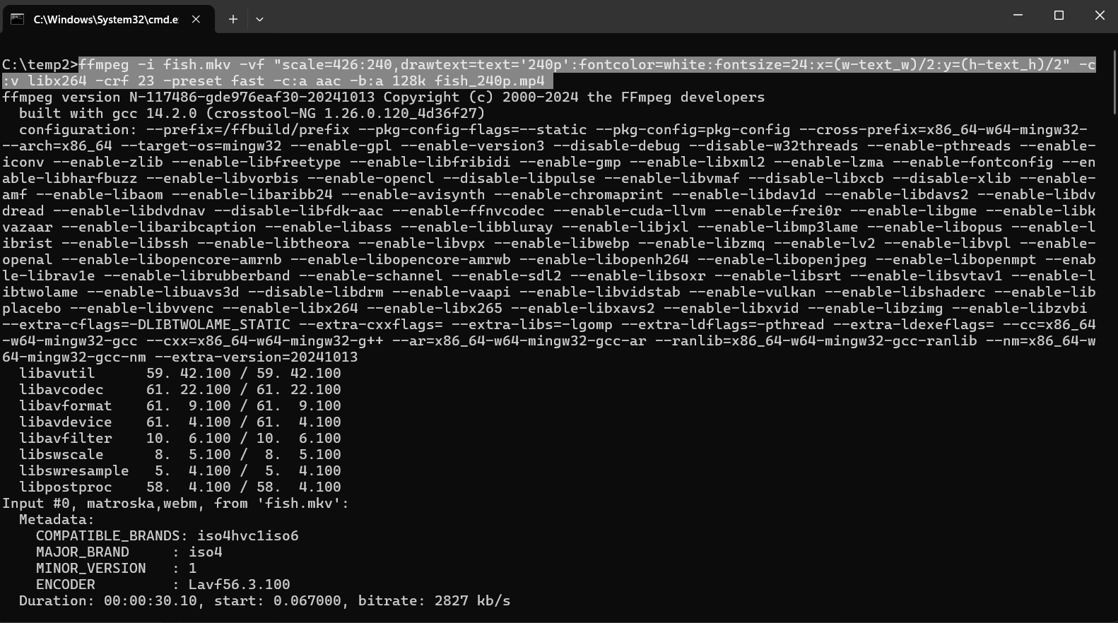
Converted Video to H 264 for 240p

Slide 5
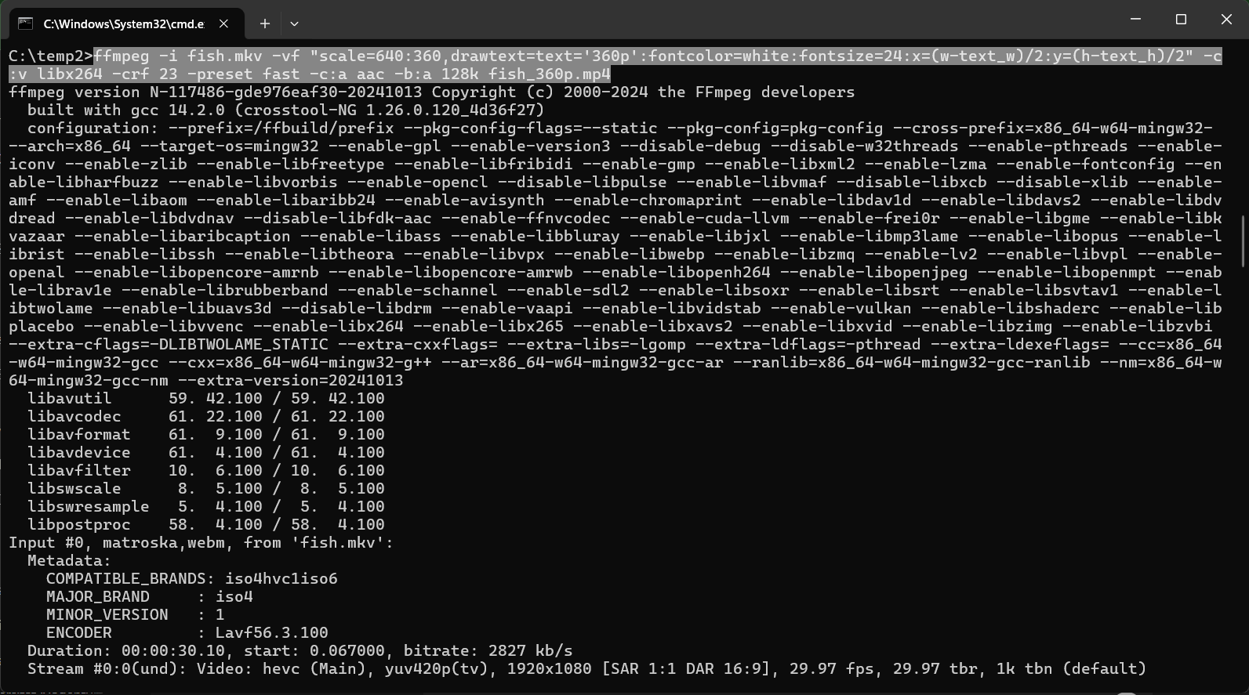
Converted Video to H 264 for 360p

Slide 6
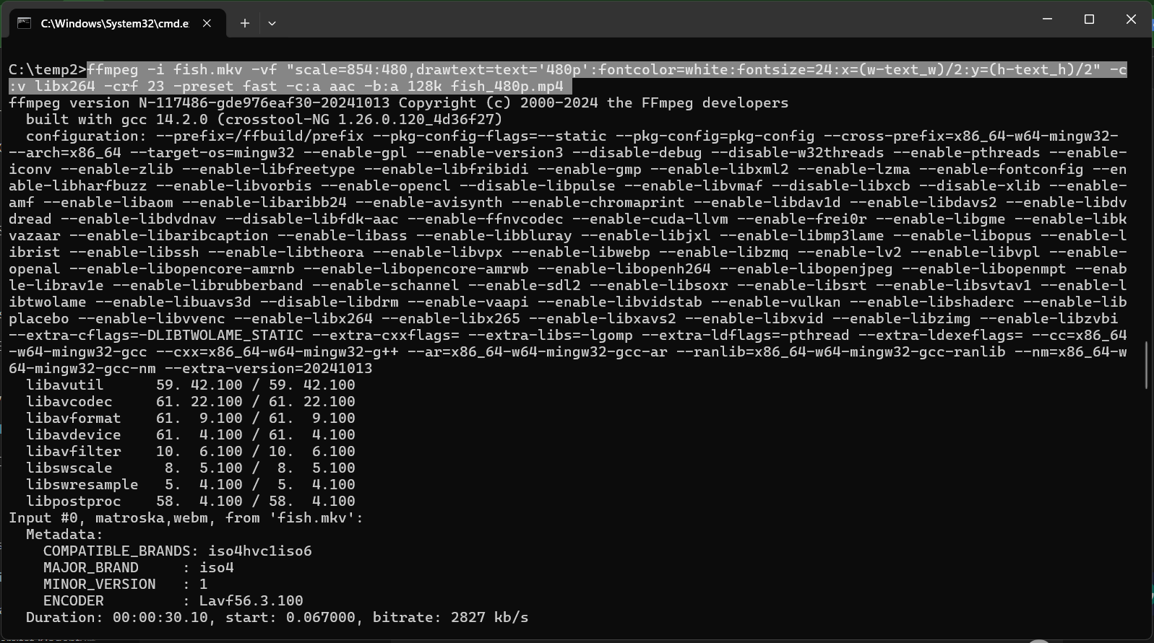
Converted Video to H 264 for 480p

Slide 7
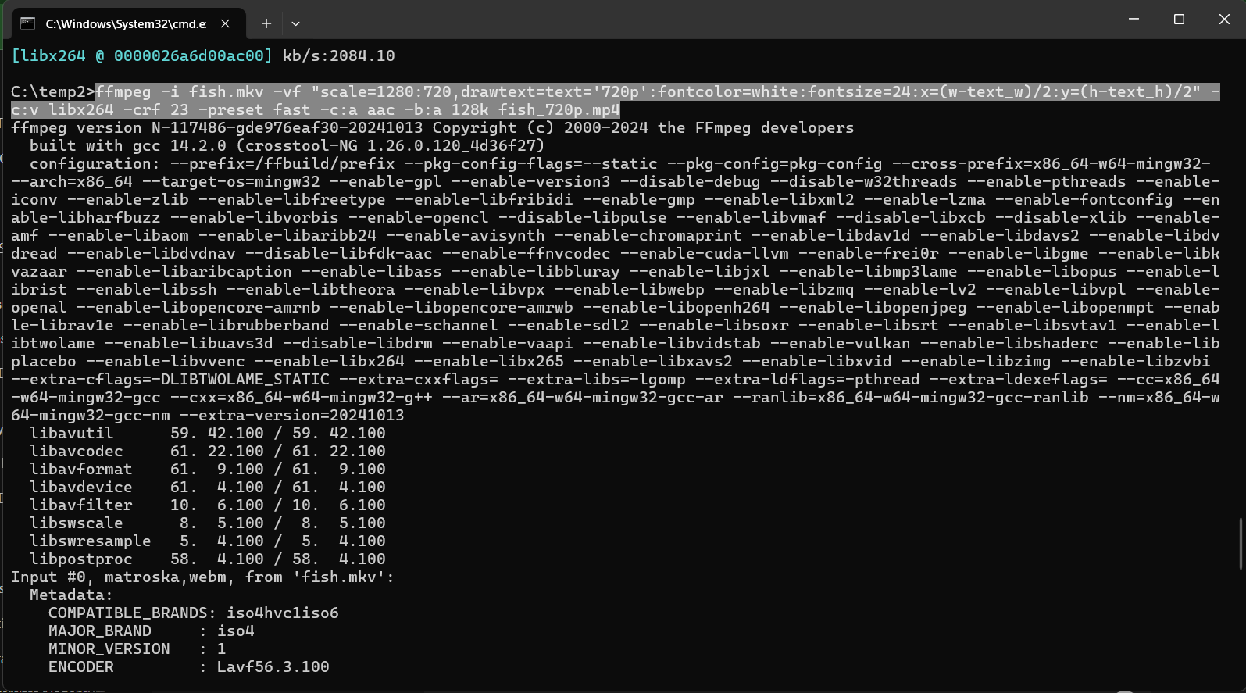
Converted Video to H 264 for 720p

Slide 8
Prepare video for multiple qualities
ffmpeg -i fish.mp4 -vf "scale=426:240" -c:v libx264 -crf 23 -preset fast -c:a aac -b:a 128k fish_240p.mp4
Input File: fish.mp4
Scale: Resizes video to 426x240 (240p).
Video Codec: libx264 (H.264 format).
CRF 23: Balances quality and file size (lower CRF = better quality).
Preset: fast for faster encoding with slight compression tradeoff.
Audio Codec: aac with 128 kbps bitrate.
Output: Saves as fish_240p.mp4.

Slide 9
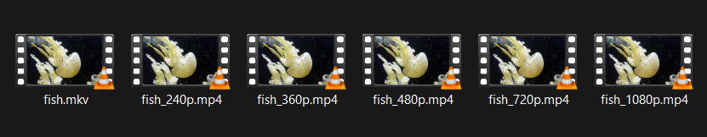
Prepare Videos

Slide 10
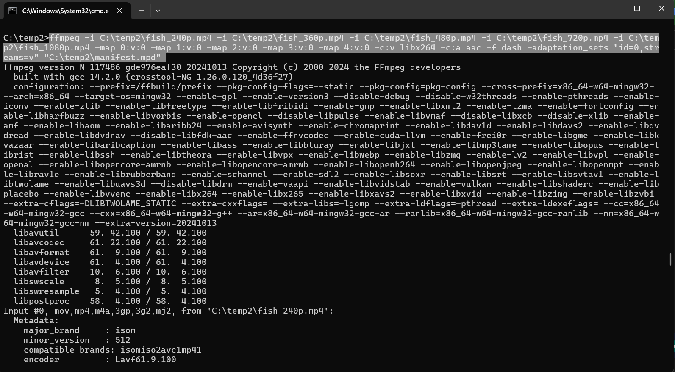
Create an MPD (Media Presentation Description) file for streaming.

Slide 11
Create an MPD (Media Presentation Description) file for streaming.
ffmpeg -i C:\temp2\fish_240p.mp4 -i C:\temp2\fish_360p.mp4 -i C:\temp2\fish_480p.mp4 -i C:\temp2\fish_720p.mp4 -i C:\temp2\fish_1080p.mp4 -map 0:v:0 -map 1:v:0 -map 2:v:0 -map 3:v:0 -map 4:v:0 -c:v libx264 -c:a aac -f dash -adaptation_sets "id=0,streams=v" "C:\temp2\manifest.mpd"
Inputs: 5 video files with resolutions (240p, 360p, 480p, 720p, 1080p).
-map: Maps the video streams from each input for DASH.
Video Codec (-c:v libx264): Encodes all streams to H.264 format.
Audio Codec (-c:a aac): Sets AAC codec for audio compatibility.
Format (-f dash): Creates MPEG-DASH for adaptive streaming.
Adaptation Sets: Groups all video streams into a single set (id=0,streams=v) for client-side adaptive playback.
Output: Generates a DASH manifest file (manifest.mpd).

Slide 12
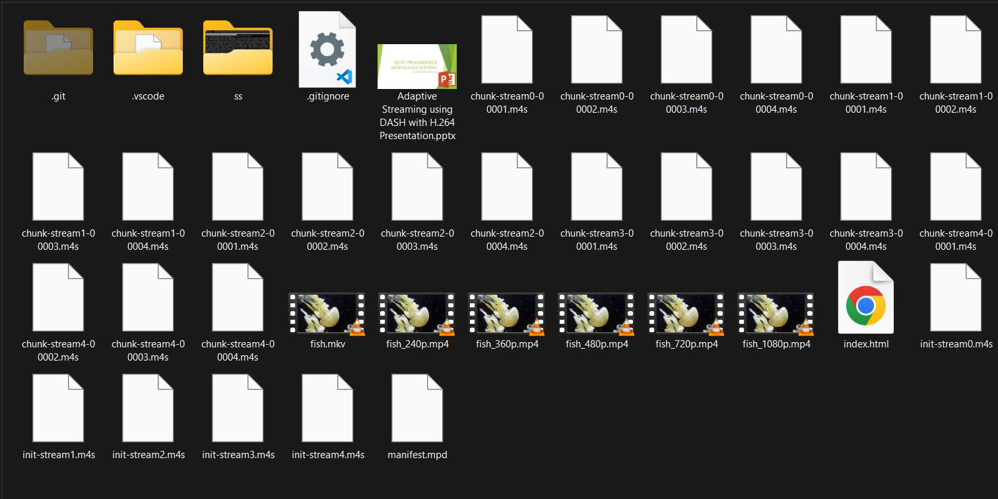
MPD Done Here

Slide 13
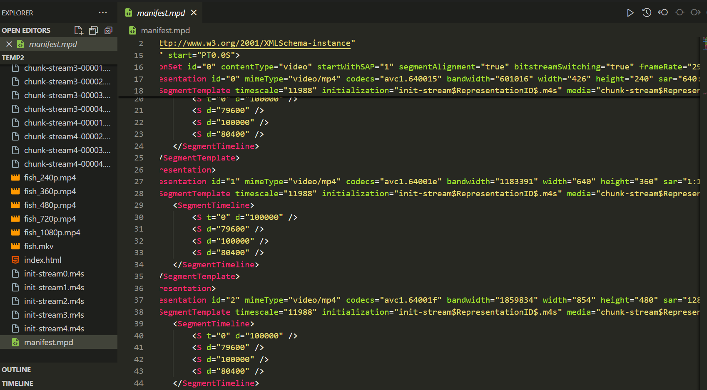
Manifest File

Slide 14
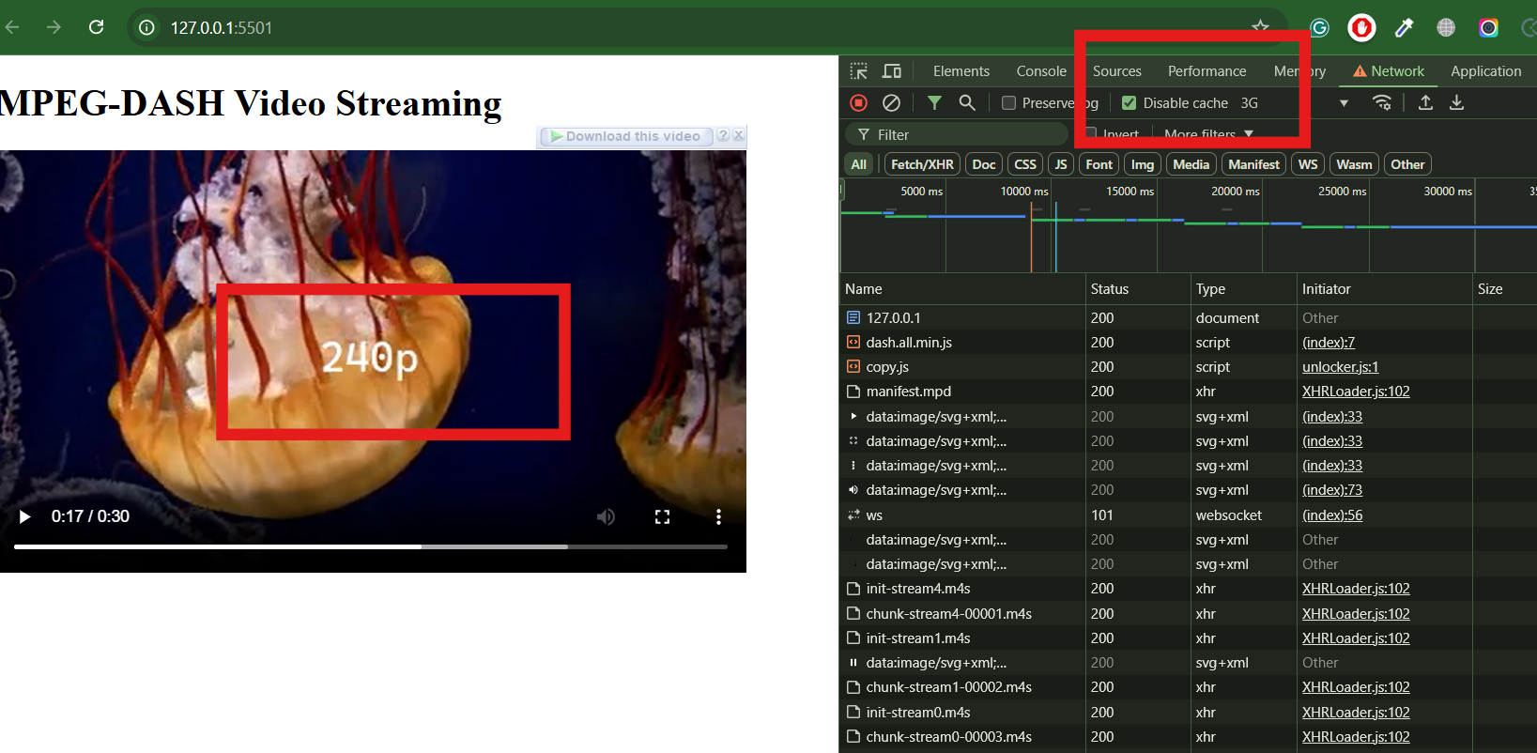
Throttling at 3G

Slide 15
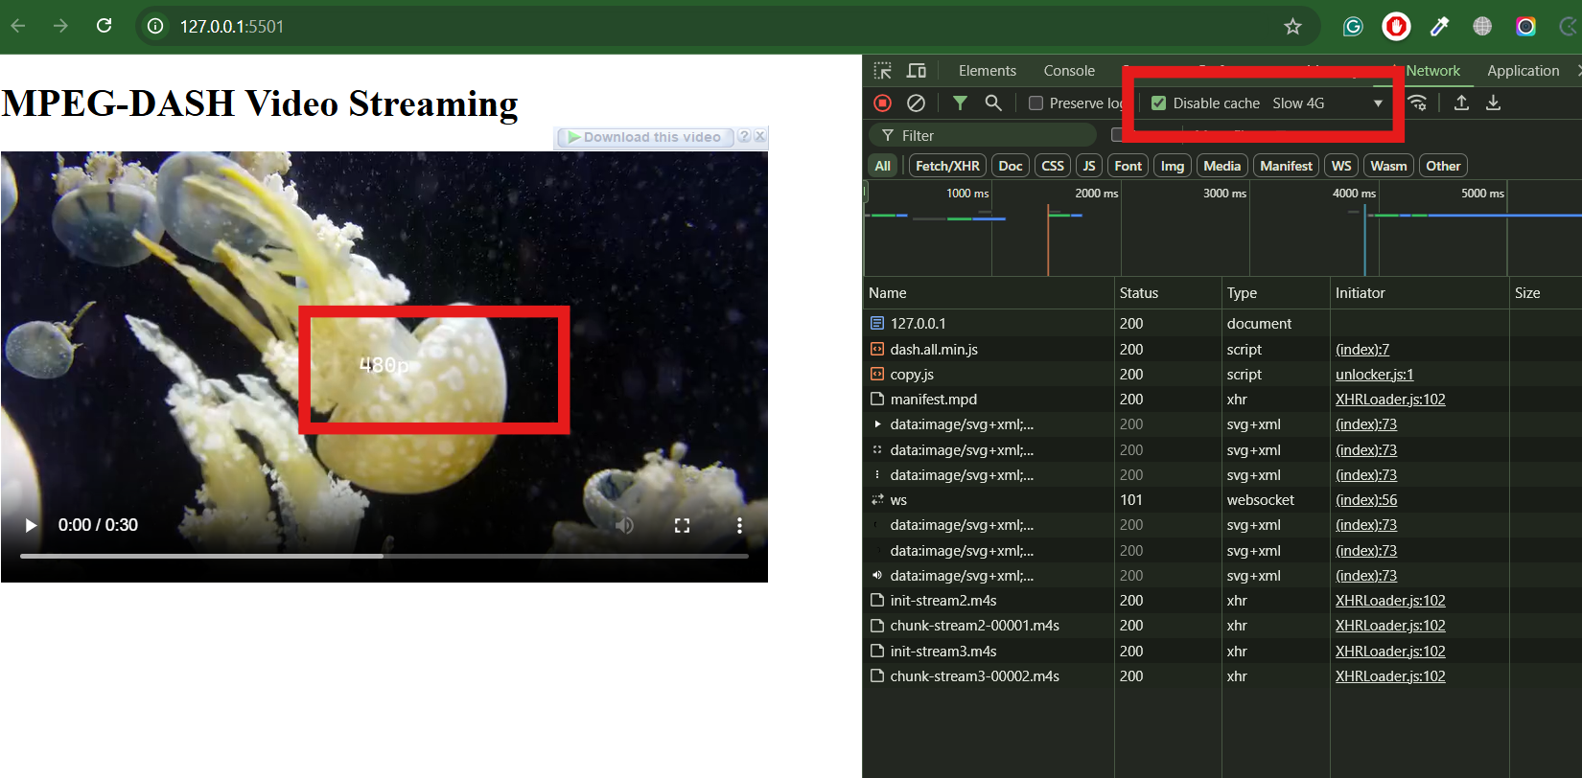
Throttling at Slow 4G

Slide 16
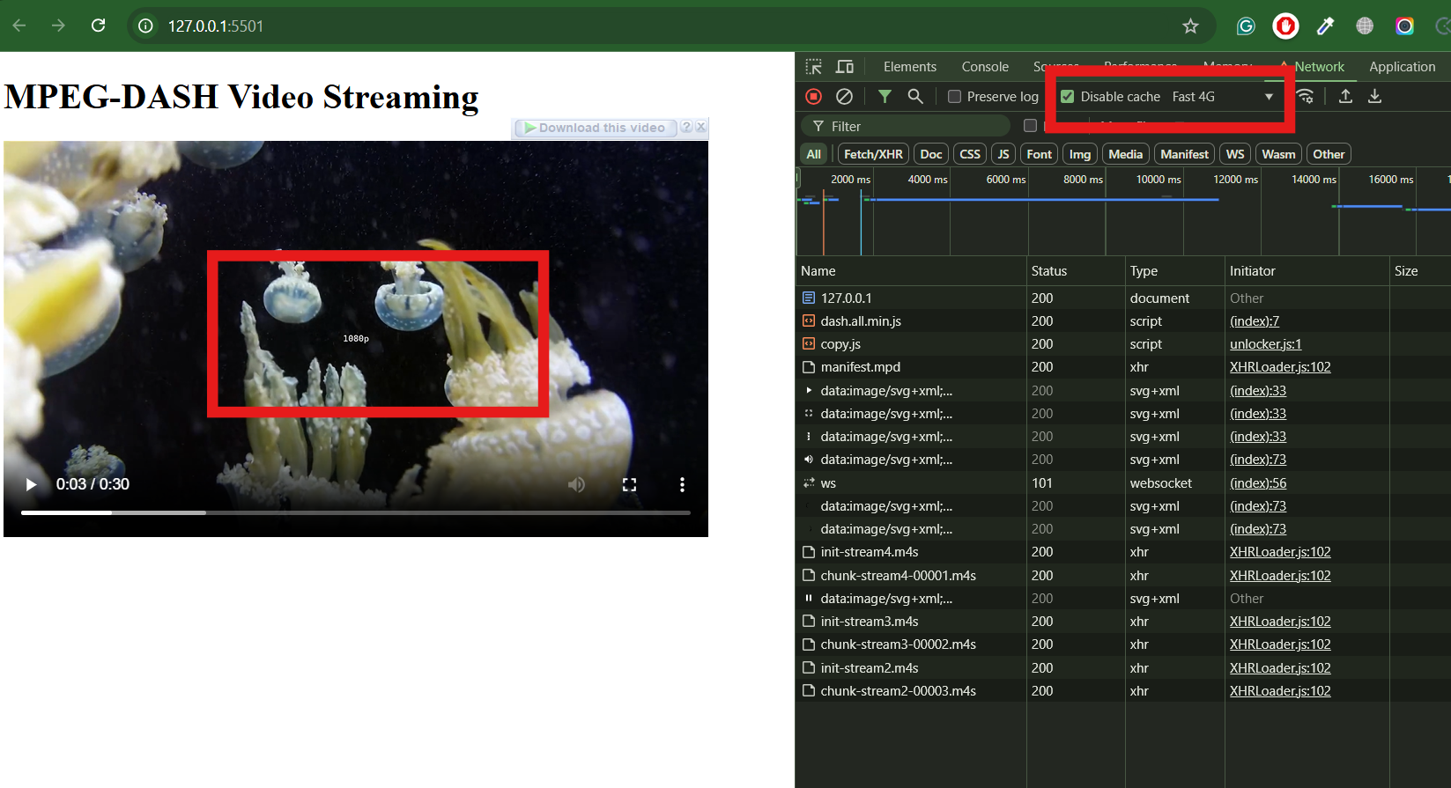
Throttling at Fast 4G

Slide 17
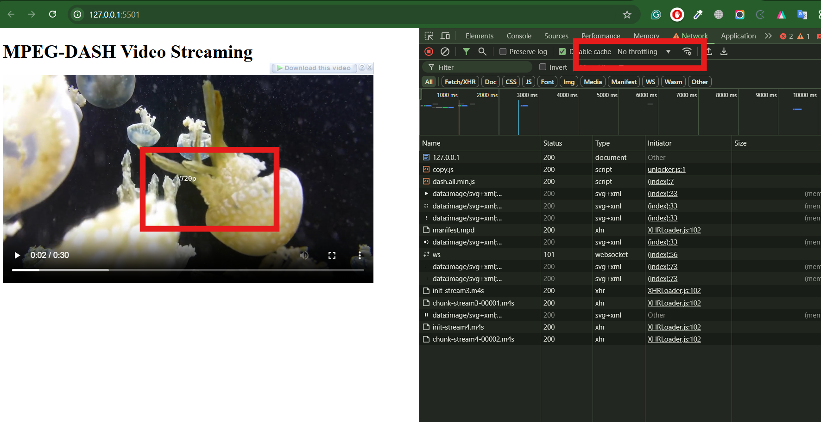
NO Throttling

Slide 18
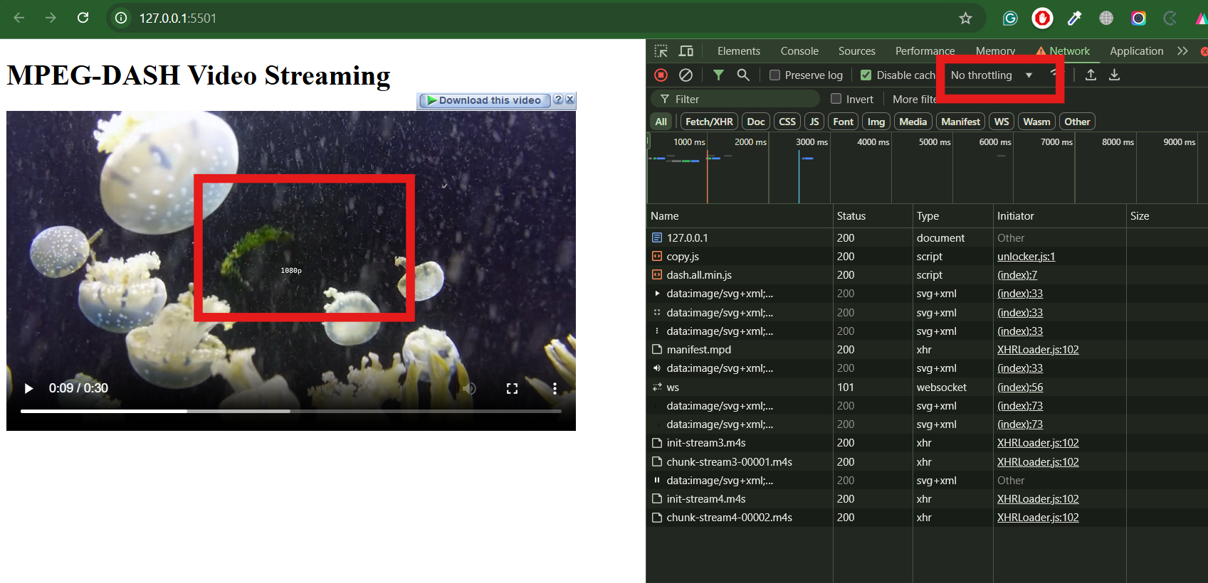
NO Throttling

Slide 19
Testing Results : Network Conditions
Network | Representation | Observations
3G | (240p) | Lowest resolution, stable playback
Slow 4G | (360p) | Medium quality, consistent playback
Fast 4G | (720p) | High-quality playback, smooth streaming
No Throttling | (1080p) | Highest quality with no buffering

Slide 20
Thank you !

